Slide 1


Medha AI
Personlized Learning Assistance
Empowering self-paced learners with AI-generated paths
Team : The Innovators
Members :
Suraj Wakhure (Team Leader)
Nikhil Datar
Shubham Deshmukh
Diksha Kulkarni

Slide 2

Problem Statement
Solve a real-world problem using at least 3 public APIs

Slide 3

Team Idea
Traditional education uses one-size-fits-all approach, leading to high dropout rates and poor outcomes. Key Problems:
📚 Students face info overload → No clear path. ⚡ Courses are static, not personalized. 🧩 No easy way to track progress step-by-step. 🎯 Result → Learners waste time & lose motivation.

Slide 4

Our Solution
Meet MedhaAI!
🧠 Step 1: Upload notes or enter topic name.
❓ Step 2: AI fires 5 smart MCQs (Gemini API).
🗺️ Step 3: MCQ score → Tailor-made roadmap.
🔓 Step 4: Unlock roadmap stage-by-stage.
📰 Bonus: Get live Reddit threads, news, book recs.

Slide 5

API usage plans
List down the tools and methods for the project and explain how they work.
Gemini API
Reddit API
News API:
Understands user input.
Generates questions + learning path.
Pulls common doubts from relevant subreddits.
Learner sees what others struggle with.
Adds “real-world relevance” to abstract concepts.
Makes learning timely and meaningful.
Back to Agenda Page
schematiq

Slide 6








Tech Stack
HTML
JavaScript
API
Express.js
FrontEnd
Backend
Add role
Simplified routing and API handling
CSS
Firebase
Node.js
Styling
Authentication
JavaScript runtime for server-side logic.

Slide 7
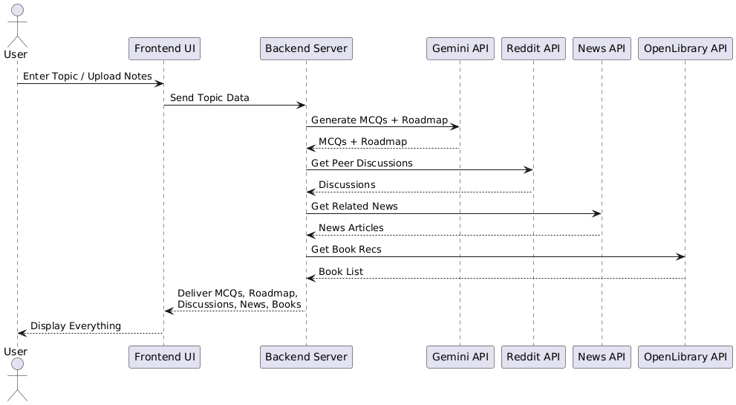
System Flow : ( Sequence Diagram)

Slide 8
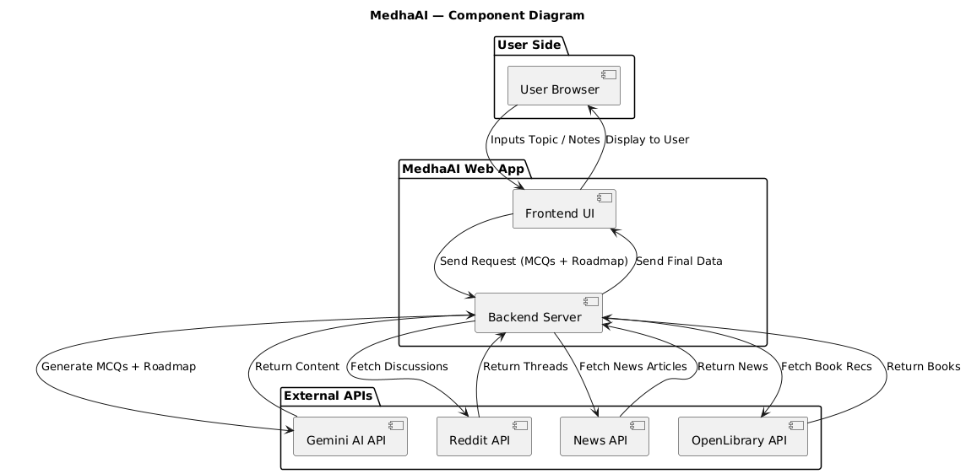
System Structure : ( Component Diagram)

Slide 9


Project Features
01
AI-Generated Roadmaps
Personalized learning paths created using Gemini AI based on user input.
02
Adaptive MCQ Testing
Auto-generated questions to assess knowledge and tailor content.
03
Note/Topic Input Flexibility
Users can upload notes or enter any topic to begin their journey.
04
Real-Time News Integration
NewsAPI adds current headlines to make learning timely and relevant.
Back to Agenda Page
schematiq

Slide 10
Project Features
05
Reddit Community Insights
Pulls common doubts, FAQs, and tips from relevant subreddits.
06
Progress-Based Adaptation
Roadmap evolves based on answers, activity, and new data trends.
07
Unlockable Content Cards
Visual, interactive learning blocks that track completion status.
08
Lightweight, No-Login Flow
Simple usage without account creation; runs on local Node server.
Back to Agenda Page
schematiq

Slide 11

Future
Scope
Multi-language Support
Advanced AI Personalization
Peer Learning Community
Drag-and-Drop Roadmap Builder
Gamified Learning
Mobile App Version
Integration with MOOCs & Courses

Slide 12



Thank you

